Slide 1

How do you tame a big ball of mud?
One test at a time.
Matt Eland
@IntegerMan
https://www.Linkedin.com/in/MattEland/
Slides and code available at: https://GitHub.com/IntegerMan/SoftwareQualityTalk/

Slide 2
About This Talk
Intended to introduce variety of tools and ideas to give you options when working with legacy code
Unit Testing 101
Improving Unit Tests
Other Tools / Processes
Conclusion
Q&A
Community Ideas
Slides and code available at: https://GitHub.com/IntegerMan/SoftwareQualityTalk/

Slide 3

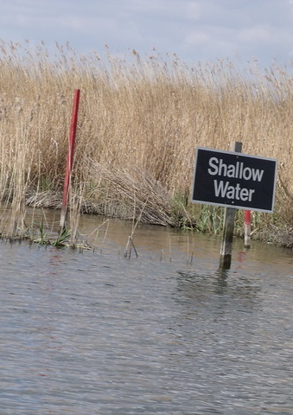
Broad & Shallow
Focused on a wide variety of libraries
Aim is to widen your exposure and spark new ideas
Will not get deep into any technology
ASP .NET, WPF, EF, Mobile, etc.
Similar alternatives exist for many libraries
Examples in C#, .NET Core, and XUnit
Slides and code available at: https://GitHub.com/IntegerMan/SoftwareQualityTalk/

Slide 4
Sample Codebase: Resume Scoring Algorithm
Resume Information
System
Under Test
Resume Score

Slide 5
It’s a Legacy System!
With Over 50k lines of code and 0 tests
And we need you to add this new feature…

Slide 6


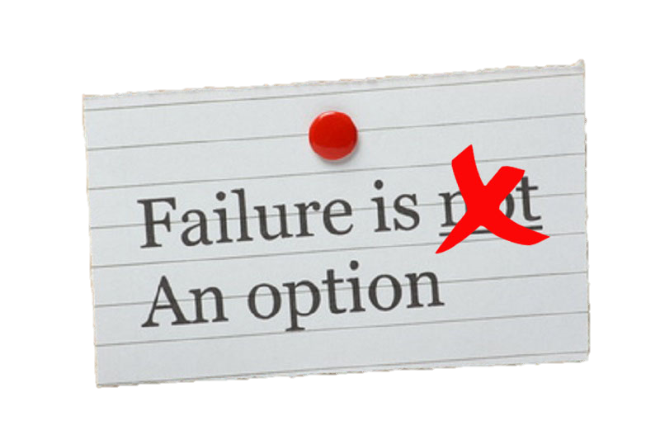


What Do You Do?

Slide 7

Build your own Safety Net

Slide 8
Unit Testing 101
Because unit tests should not be an endangered species.

Slide 9
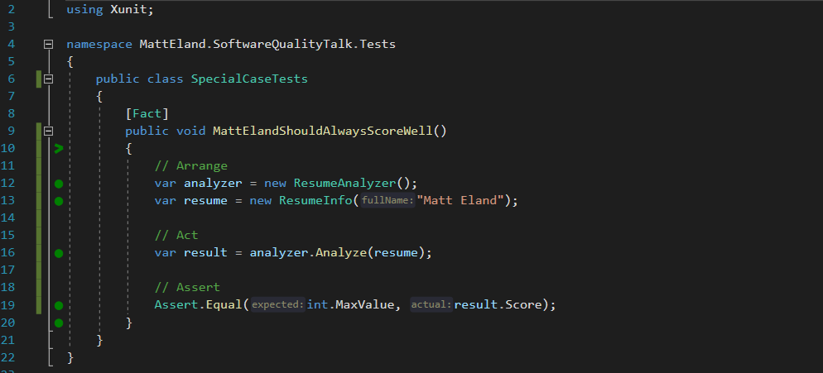
What is a Unit Test?

Slide 10



Unit Testing Frameworks
MSTest
NUnit
XUnit
Already installed in Visual Studio
[TestMethod] / [DataTestMethod]
MSTest2 closes gaps the original had
Port of frameworks like JUnit
[Test] / [TestCase]
Often more integration support
More recent addition
[Fact] / [Theory]
More favored in .NET Core
See https://raygun.com/blog/unit-testing-frameworks-c/ for detailed analysis of different frameworks

Slide 11
Test Driven Development (TDD)
Green
Clean up System Under Test
Red
Write a failing test
Make the test pass
Refactor

Slide 12

But I can’t test my code because _______________ !

Slide 13
But I can’t test my code because _______________ !
it works with the UI
Some options:
Then don’t write tests for it.
Make the view layer as small and dumb as possible, then test the rest
Supplement with Automated UI Testing as needed

Slide 14
But I can’t test my code because _______________ !
Database Dependencies
Some options:
Remove the database dependency via Dependency Injection
Use Entity Framework and in-memory database tests
Keep talking to the database, but work around the limitation

Slide 15
But I can’t test my code because _______________ !
it’s a big ball of mud
Some options:
Git Gud
Don’t test, but expect bugs in the legacy system when changes arise
Place some “pinning tests”, then refactor to a better architecture

Slide 16
Taming a big ball of mud
Build a Safety Net
Improve Testability
Improve your Tests
Refactor the Code
Expand Your Tests

Slide 17
Build a Safety Net
If you don’t pin down current behavior, you won’t know when you change it

Slide 18
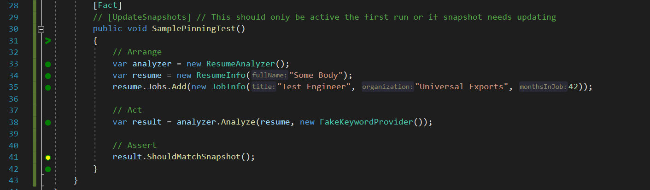
Testing Object State with Snapper
GitHub Repo: https://theramis.github.io/Snapper/

Slide 19
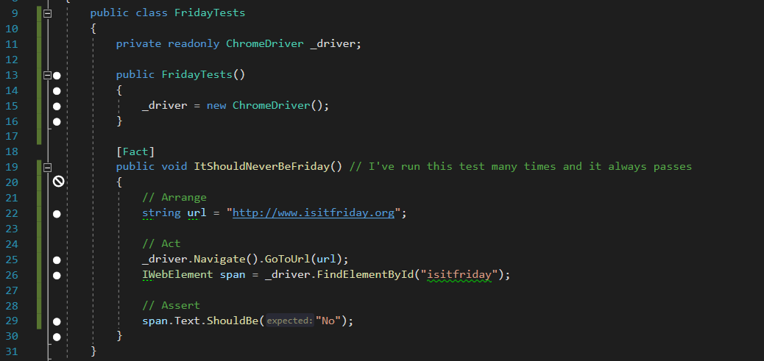
Selenium WebDriver Tests
GitHub Repo: https://github.com/SeleniumHQ/selenium

Slide 20
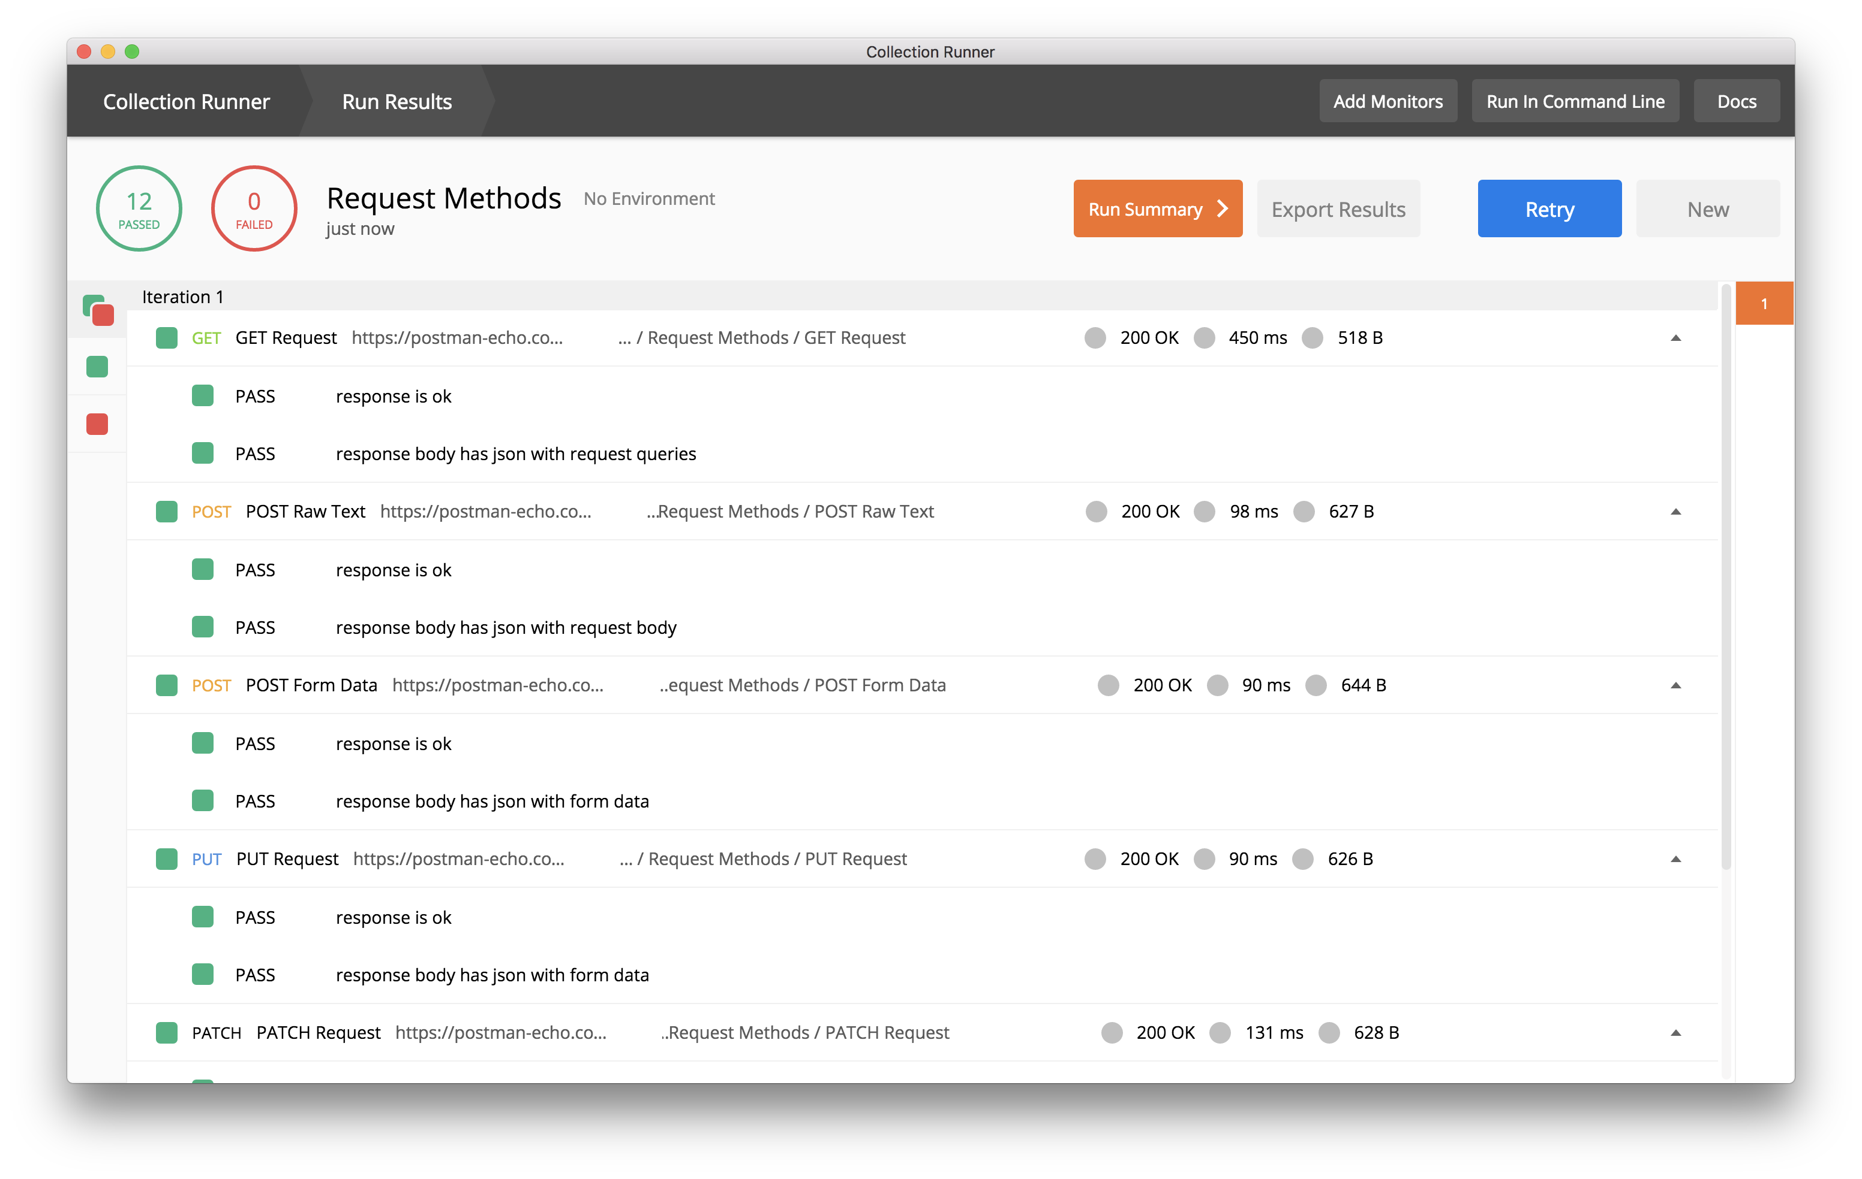
Postman Collections For API Testing
API Testing Blog Post: https://blog.getpostman.com/2017/10/25/writing-tests-in-postman/

Slide 21
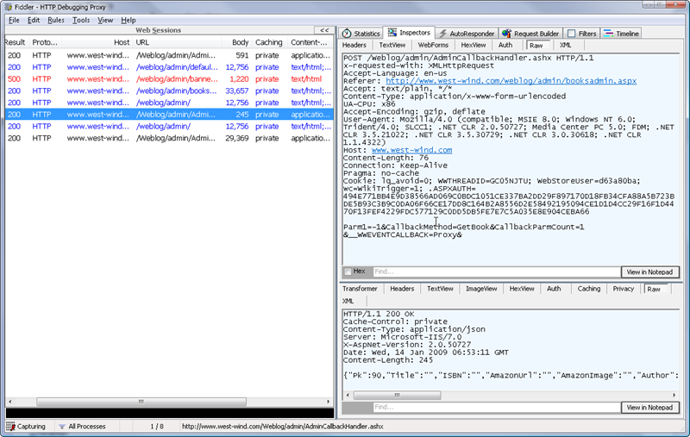
Inspecting Web Traffic with Fiddler
Product Page: https://www.telerik.com/fiddler

Slide 22
Improve Testability
If everything is tied together, all we’re doing is integration tests

Slide 23
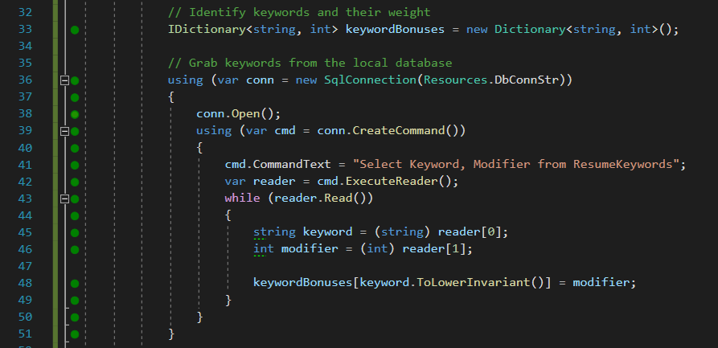
Removing Database Dependencies Example

Slide 24
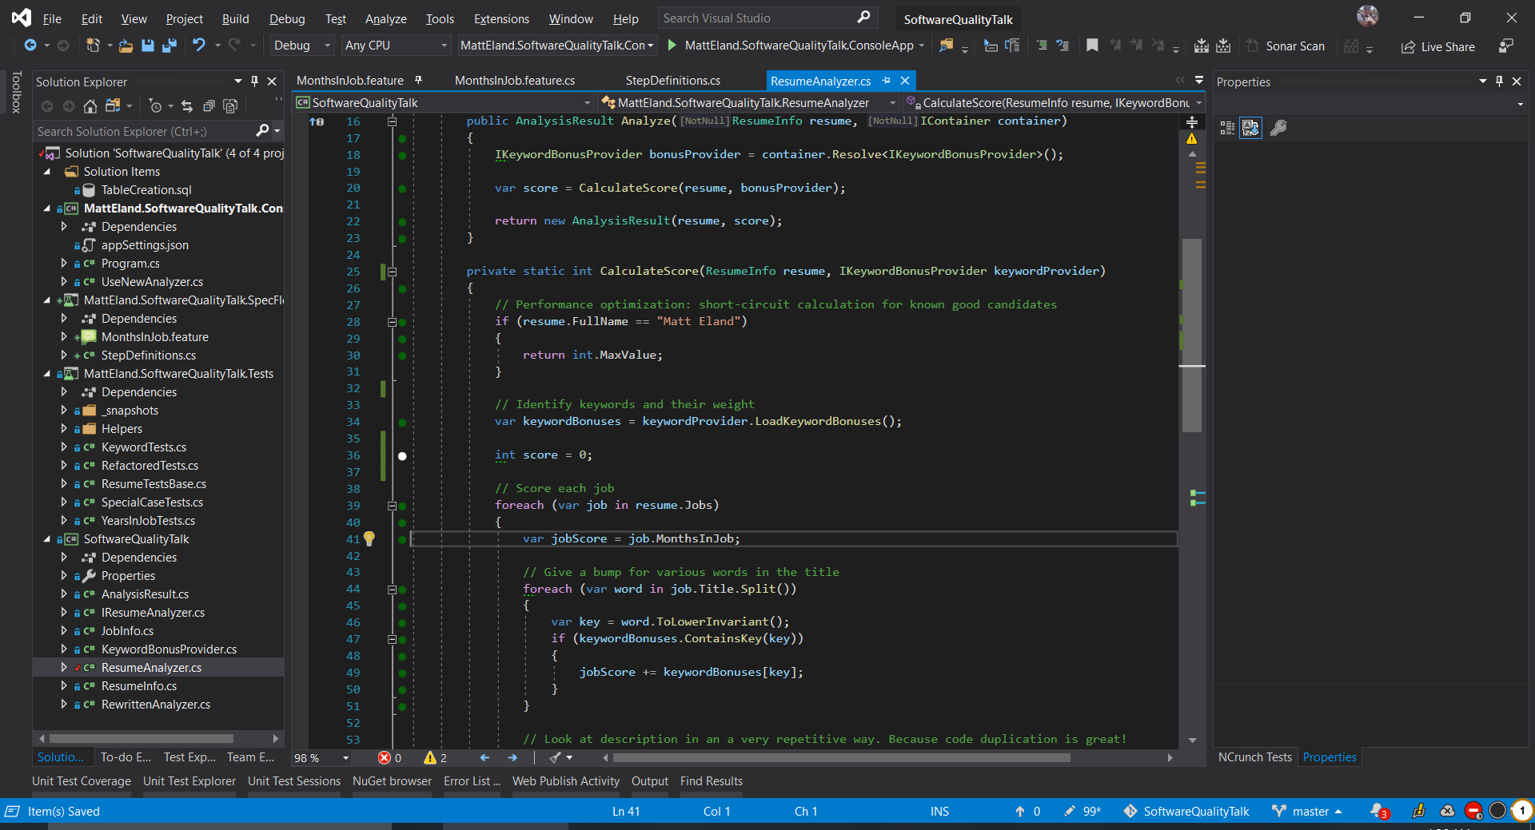
Removing Database Dependencies Example

Slide 25
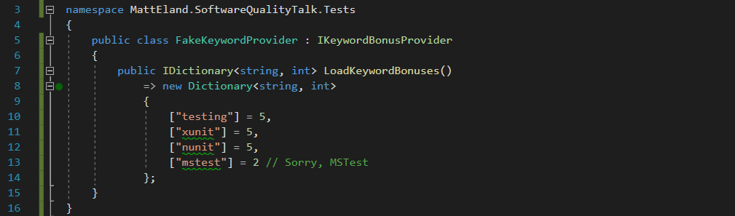
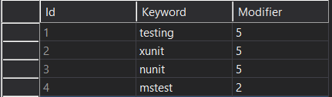
Removing Database Dependencies Example

Slide 26
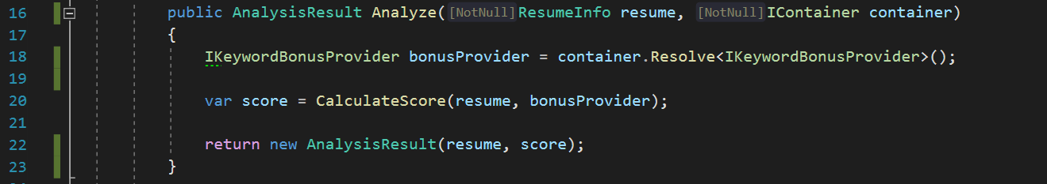
Inversion of Control with AutoFac
GitHub Repo: https://github.com/autofac/Autofac

Slide 27
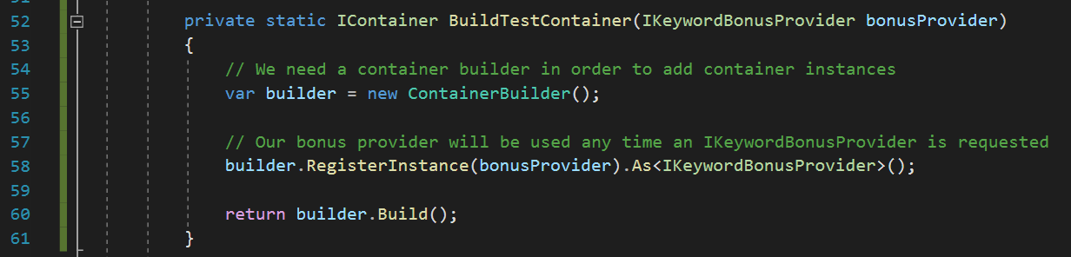
Inversion of Control with AutoFac
GitHub Repo: https://github.com/autofac/Autofac

Slide 28
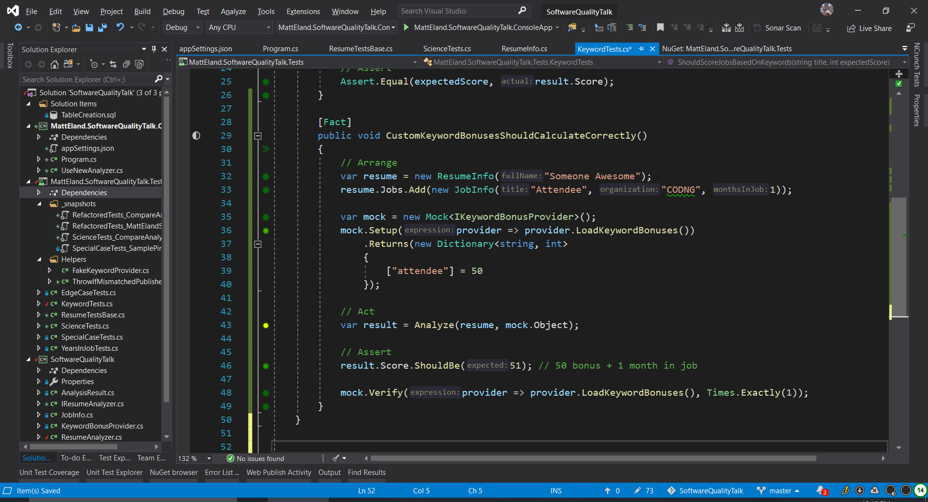
Moq to Simplify Fake Object Creation
GitHub Repo: https://github.com/Moq/moq4

Slide 29
Moq to Simplify Fake Object Creation
GitHub Repo: https://github.com/Moq/moq4

Slide 30
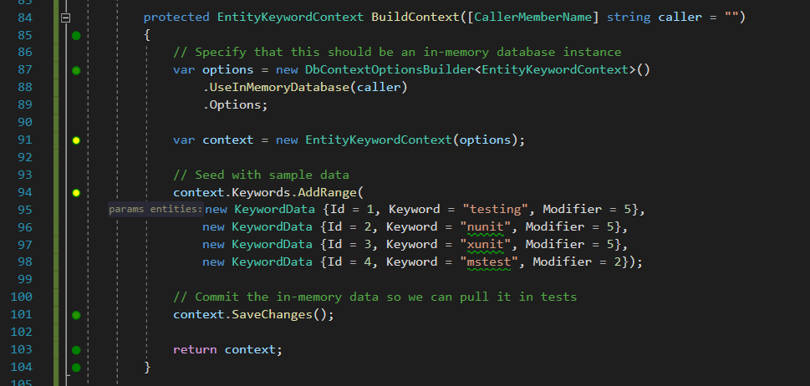
In Memory Tests with Entity Framework Core

Slide 31
Improve Your Tests
Before we scale our tests up, we need to make sure we’re happy with them

Slide 32
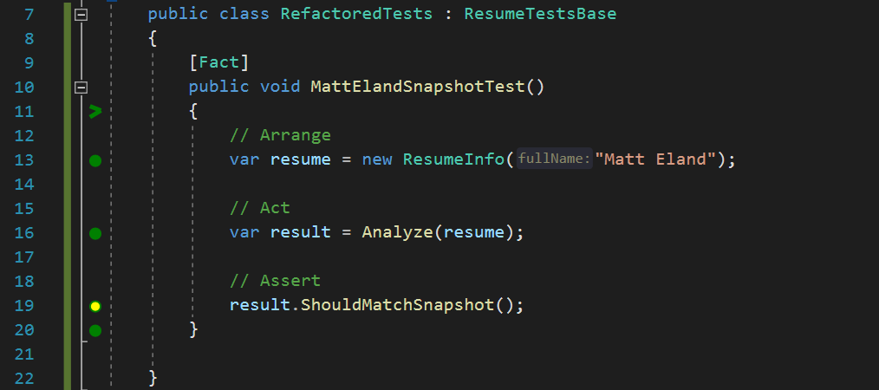
Refactor your Test Code

Slide 33
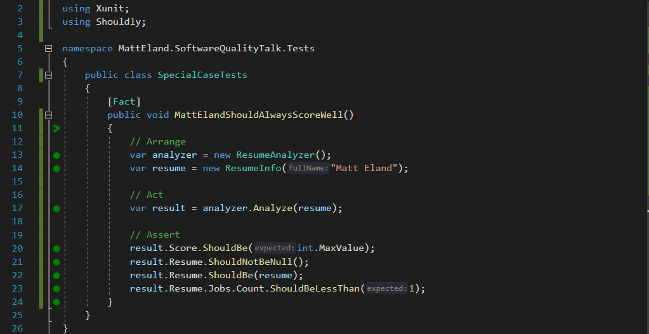
Shouldly
Nice and readable, plus I’ll never confuse actual and expected ordering again.
GitHub Repo: https://github.com/shouldly/shouldly

Slide 34
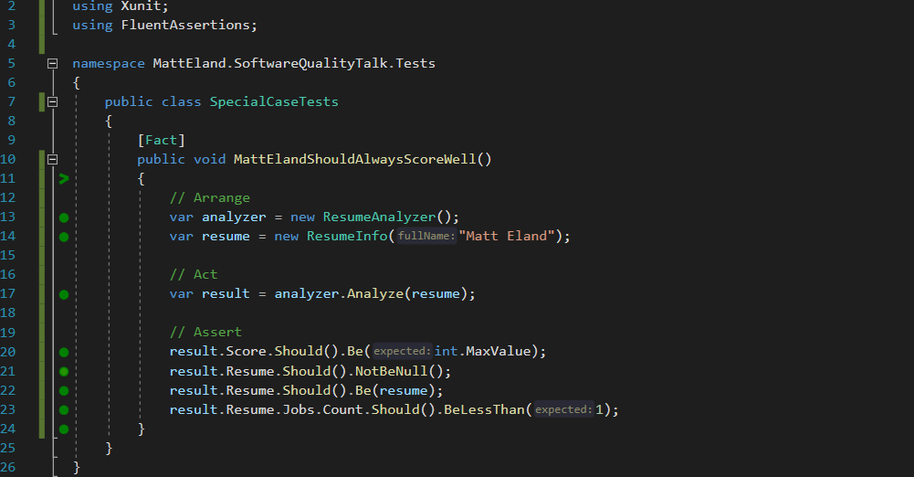
FluentAssertions
The same as Shouldly, except now with more parentheses
GitHub Repo: https://github.com/fluentassertions/fluentassertions

Slide 35
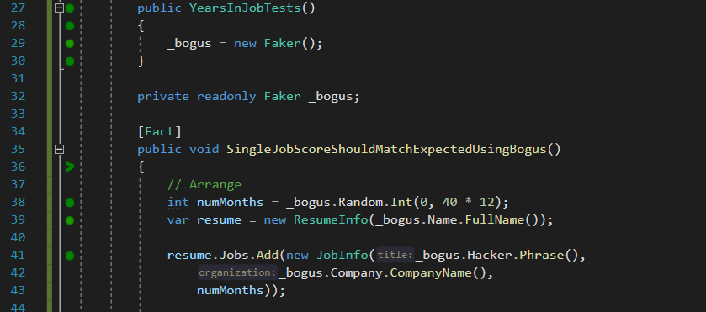
Generating Test Data with Bogus
GitHub Repo: https://github.com/bchavez/Bogus

Slide 36
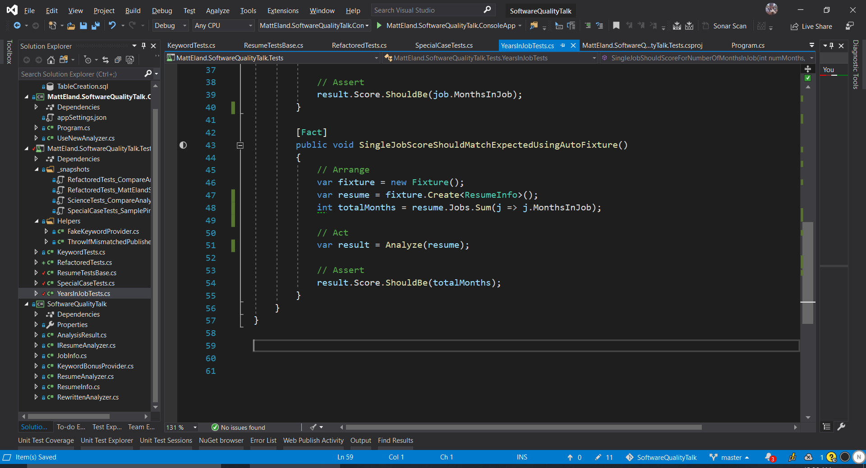
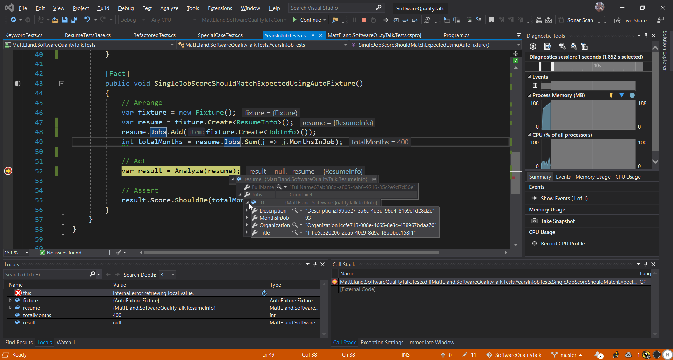
AutoFixture
GitHub Repo: https://github.com/AutoFixture/AutoFixture

Slide 37
Refactor the Code
Stand back, I’m going to try science!

Slide 38
Typical Deployments
Client
Legacy Routine
New Routine

Slide 39
Typical Rollbacks
Client
Legacy Routine
New (Buggy) Routine

Slide 40
Victimless Canary Testing with Scientist .NET
Client
Scientist .NET
Legacy Routine
New Routine
GitHub Repo: https://GitHub.com/ScientistProject/Scientist.net

Slide 41
Victimless Canary Testing with Scientist .NET
Client
Scientist .NET
Legacy Routine
Results Publisher
New Routine
GitHub Repo: https://GitHub.com/ScientistProject/Scientist.net

Slide 42
Unit Testing with Scientist .NET
Unit Test
Scientist .NET
Legacy Routine
Results Publisher
New Routine
GitHub Repo: https://GitHub.com/ScientistProject/Scientist.net

Slide 43
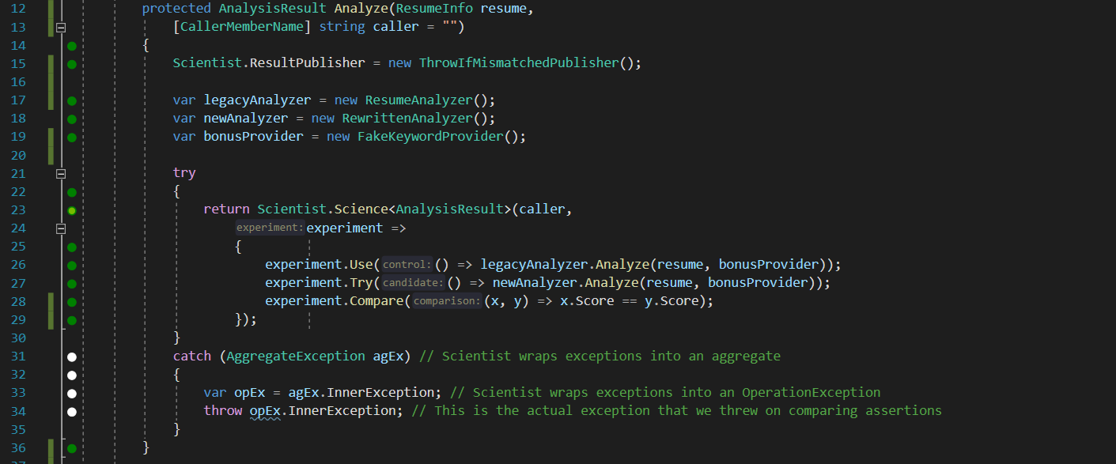
Experiments with Scientist .NET
GitHub Repo: https://GitHub.com/ScientistProject/Scientist.net

Slide 44
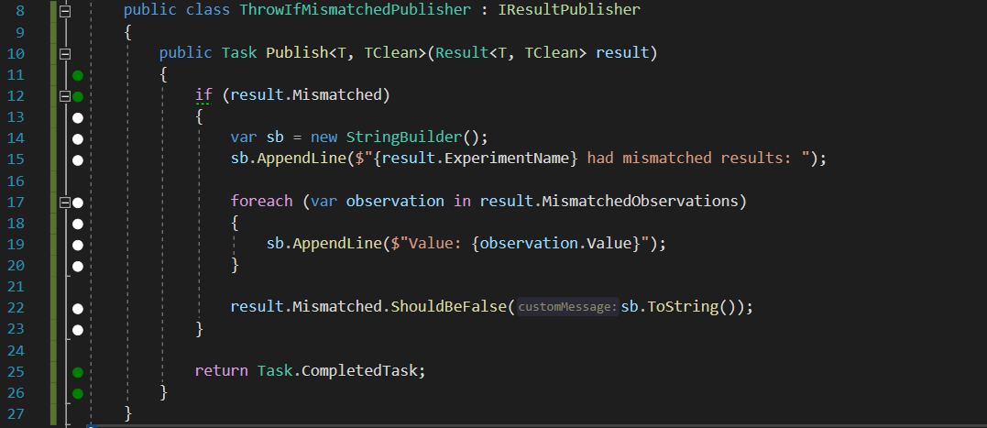
Publishing Results with Scientist .NET
GitHub Repo: https://GitHub.com/ScientistProject/Scientist.net

Slide 45
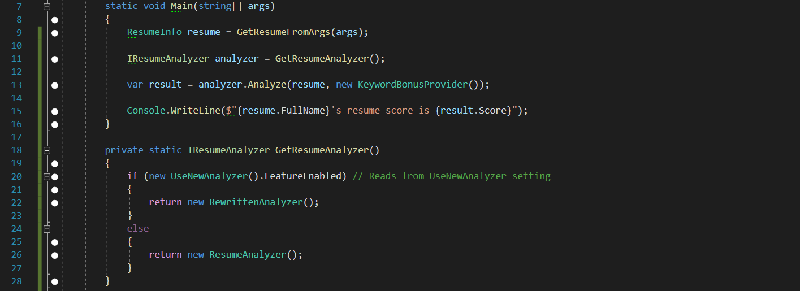
Adding a Fallback Option with FeatureToggle
GitHub Repo: https://GitHub.com/jason-roberts/FeatureToggle

Slide 46
Expand the Tests
“The unit tests must flow”
- Nobody (that I know of)

Slide 47
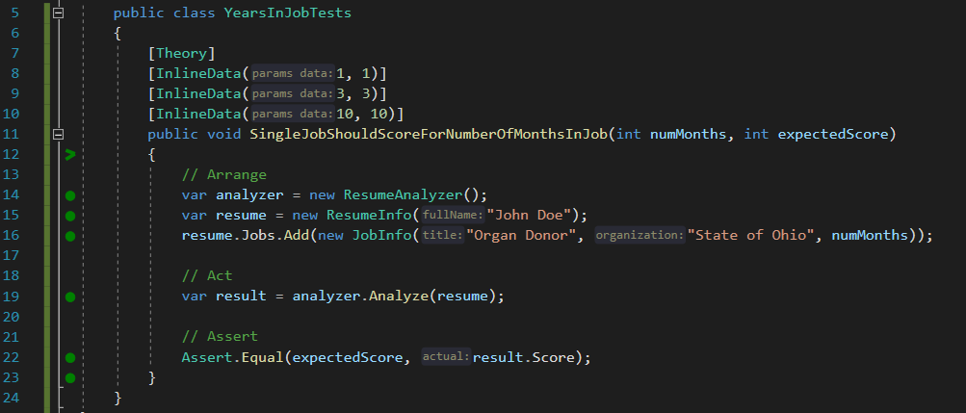
Parameterized Unit Tests

Slide 48
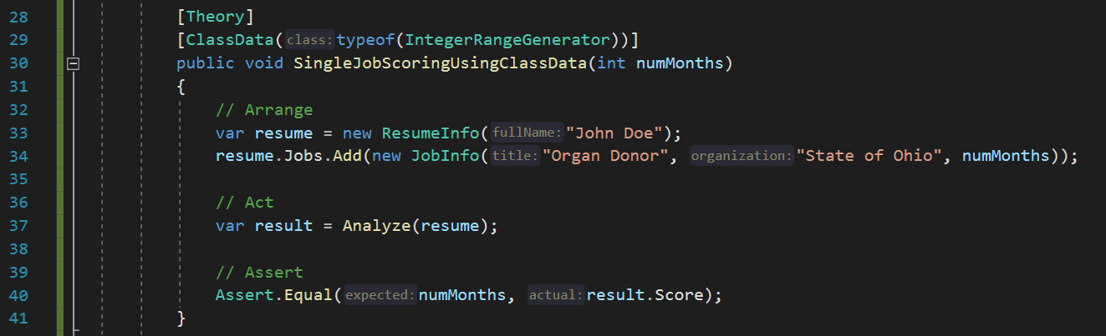
Class Data Tests for Custom Data

Slide 49
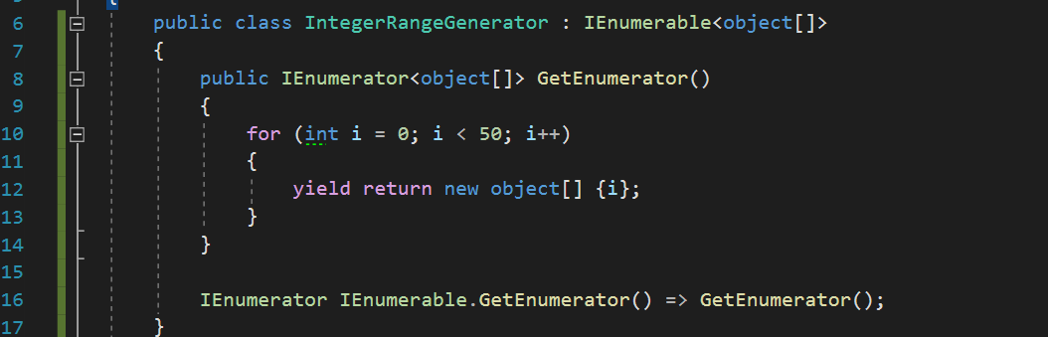
Class Data Tests for Custom Data

Slide 50
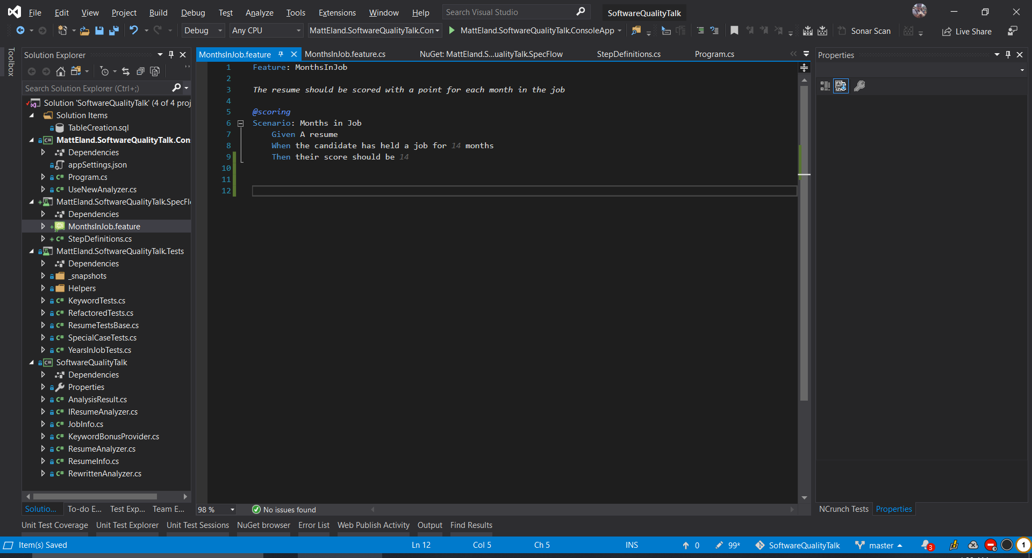
Behavior Driven Development with SpecFlow
Home Page: https://specflow.org/

Slide 51
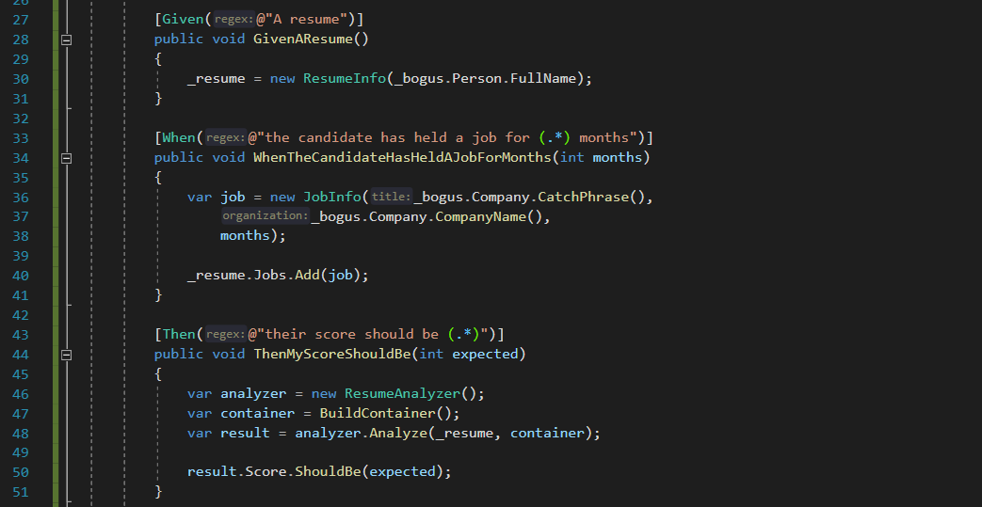
SpecFlow Steps Definitions
Home Page: https://specflow.org/

Slide 52
Tools & Processes
Because there’s more to quality than just code

Slide 53
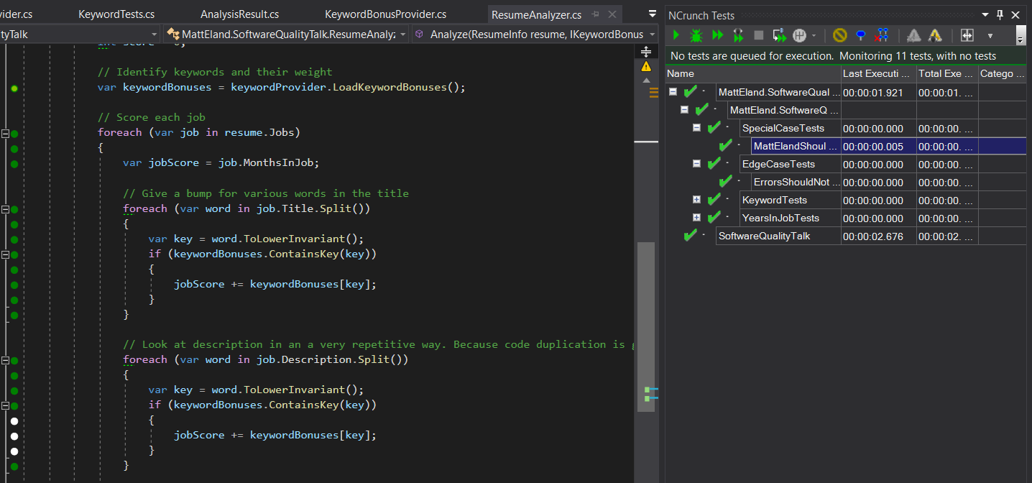
NCrunch
Passing test, but takes longer to execute than other lines
Covered by passing tests
These lines not covered by any tests
NCrunch: https://www.ncrunch.net/

Slide 54
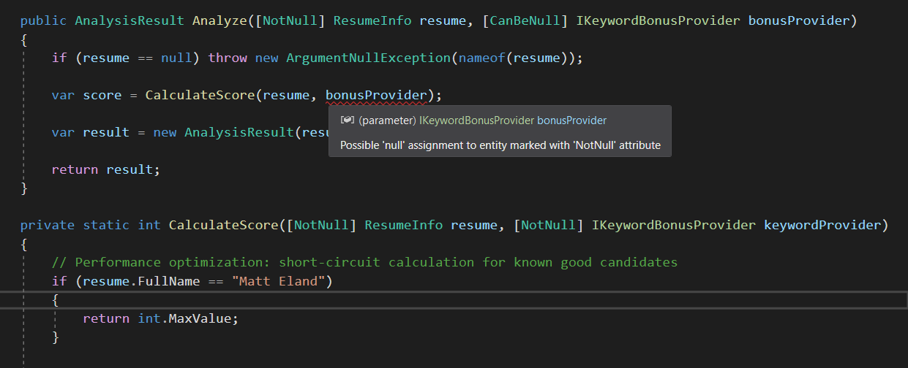
JetBrains Annotations
JetBrains Annotations Blog Post: https://tinyurl.com/jetbrains-annotations

Slide 55

Code Reviews
All Code is Peer Reviewed before testing occurs
Reviews can be informal to extremely formal
Best results if
Authors review their own code before submitting
Reviewers make multiple “themed” passes
Tracked via a system

Slide 56
CI/CD Pipeline Integration
Restore Dependencies
Build
Run Tests
Run Code Analysis
Publish Results
Track metrics over time
Integrate results into code review process
Should be repeatable
Notify on failure
Store build artifacts
Publish build status
Possibly deploy software
TeamCity: https://www.jetbrains.com/teamcity/

Slide 57
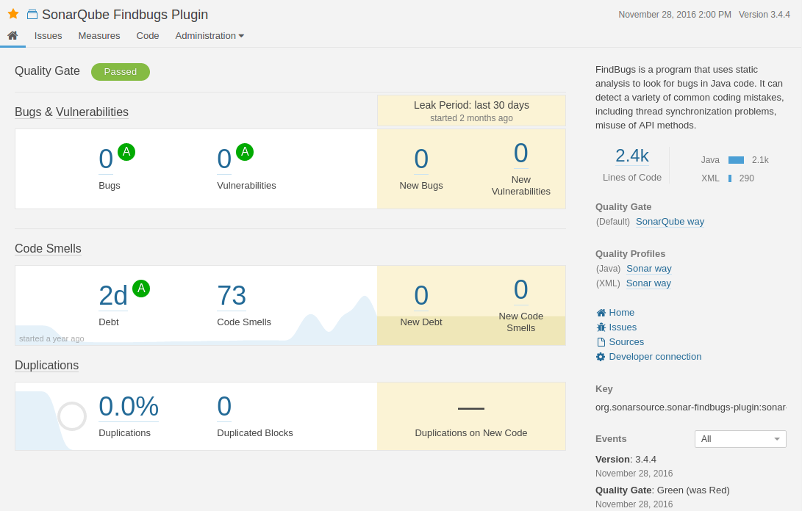
Code Analysis with SonarQube
SonarQube: https://www.sonarqube.org/

Slide 58
Test Plans
Write Test Plans before coding
Write unit tests around test plans
Expand as needed after development work is done
Include Test Plans in Code Review
When handing a feature off to QA…
Provide the test plan you followed as a rough draft
Provide the list of unit tests added
Helps find edge cases
Helps others understand the change more

Slide 59
Functional Programming
Immutability / Pure Functions
Readonly Properties
Immutable Collections
Make Invalid State Impossible
F# Discriminated Unions
OneOf Library https://github.com/mcintyre321/OneOf
Functional Programming in C#
Language-Ext Library https://github.com/louthy/language-ext
Functional Programming in F#
Can call C#
Can be called by C#

Slide 60
Conclusion
Slides and Code Available At: Https://GitHub.Com/IntegerMan/SoftwareQualityTalk/

Slide 61
Let’s Review
Build a Safety Net
Improve Testability
Improve your Tests
Refactor the Code
Expand Your Tests
Snapper
AutoFac
Shouldly
Scientist .NET
FeatureToggle
SpecFlow
AutoFixture
Bogus
Moq
Parameterized Tests
Selenium
Fiddler
SonarQube
In Memory EF
Slides and code available at: https://GitHub.com/IntegerMan/SoftwareQualityTalk/

Slide 62
Next Steps
Working Effectively with Legacy Code
Developer Testing
XUnit Test Patterns
Measuring the Software Process
The Practical Guide to Defect Prevention
Slides and code available at: https://GitHub.com/IntegerMan/SoftwareQualityTalk/

Slide 63
Questions? Other Quality Recipes?
Slides and Code Available at: Https://GitHub.Com/IntegerMan/SoftwareQualityTalk/

